Slide 1
The Value in Representing InnovAge PACE

Slide 2
Our Mission Statement
The mission of InnovAge is to enable seniors to live life on their terms – by aging in place, in their own homes and communities, for as long as safely possible. The primary way we do this is through PACE. InnovAge is committed to expanding PACE to serve more seniors in more communities.

Slide 3
Who is InnovAge?
We are the largest PACE operator in the country, with over 35 years of experience.
We operate in six states: CA, CO, NM, FL, VA, PA
We operate the PACE program on behalf of CMS.

Slide 4

Northern California
Our Sacramento Center serves the following counties…
El Dorado (partial)
Placer (full)
Sacramento (full)
San Joaquin (partial)
Sutter (full)
Yuba (partial)
CAN WE REMOVE THE PARTIAL AND FULL EXCEPTIONS? CANNOT ANALYZE ALL STATES IN TIME.
Download Service Area Zip Codes

Slide 5
Southern California
Our Crenshaw (LA) and San Bernardino centers serve the following counties…
Los Angeles
San Bernardino
Riverside
Download Service Area Zip Codes

Slide 6
Colorado
We have six centers that serve the following counties…
Adams
Arapahoe
Broomfield
Denver
Jefferson
Larimer
Pueblo
Weld
Download Service Area Zip Codes

Slide 7
New Mexico
Our Albuquerque Center serves the following counties…
Bernalillo
Sandoval
Valencia
Download Service Area Zip Codes

Slide 8
Florida
Our Orlando and Tampa centers serve the following counties…
Pasco
Hernando
Hillsborough
Lake
Orange
Osceola
Santa Rosa
Seminole
Download Service Area Zip Codes

Slide 9
Virginia
We have four centers that serve the following counties…
Albemarle
Bedford
Botetourt
Buckingham
Caroline
Charles City
Charlottesville City
Chesterfield
Colonial Heights City
Dinwiddie
Floy
Fluvanna
Franklin
Goochland
Greene
Hampton City
Hanover
Henrico
King William
Louisa
Montgomery
Nelson
New Kent
Newport News City
Orange
Petersburg
Poquoson City
Powhatan
Prince George
Richmond City
Roanoke/City
Salem
Sussex
York
Download Service Area Zip Codes

Slide 10
Pennsylvania
Our Henry Avenue and Pennypack centers serve the following counties…
Philadelphia
Download Service Area Zip Codes

Slide 11
PACE… Program of All-Inclusive Care for the Elderly
Comprehensive Care Model
PACE integrates medical, social, and long-term services, promoting independence and quality of life for seniors, while addressing their complex health and social needs through a coordinated, individualized approach.

Slide 12
PACE Centers are part medical center and part adult social/recreation center.
Medical Center
Adult Social/Recreation Center
Primary care
Dentistry
Vision
Hearing
Foot Care
OTC & Pharmacy delivery (InnovAge owned)
Counseling (phycology, behavior, nutrition, etc.)
Therapies (occupational, physical, speech)
Specialty care and emergency care are delivered through our provider network (or out-of-network)
And more
Provides a means for important social engagement commonly unavailable at home
breakfast and lunch daily
Food shipped to home for members that have food insecurity- vendor state specific (set up with IDT)
Structured activities
Unstructured/independent activities
Entertainment
And more

Slide 13
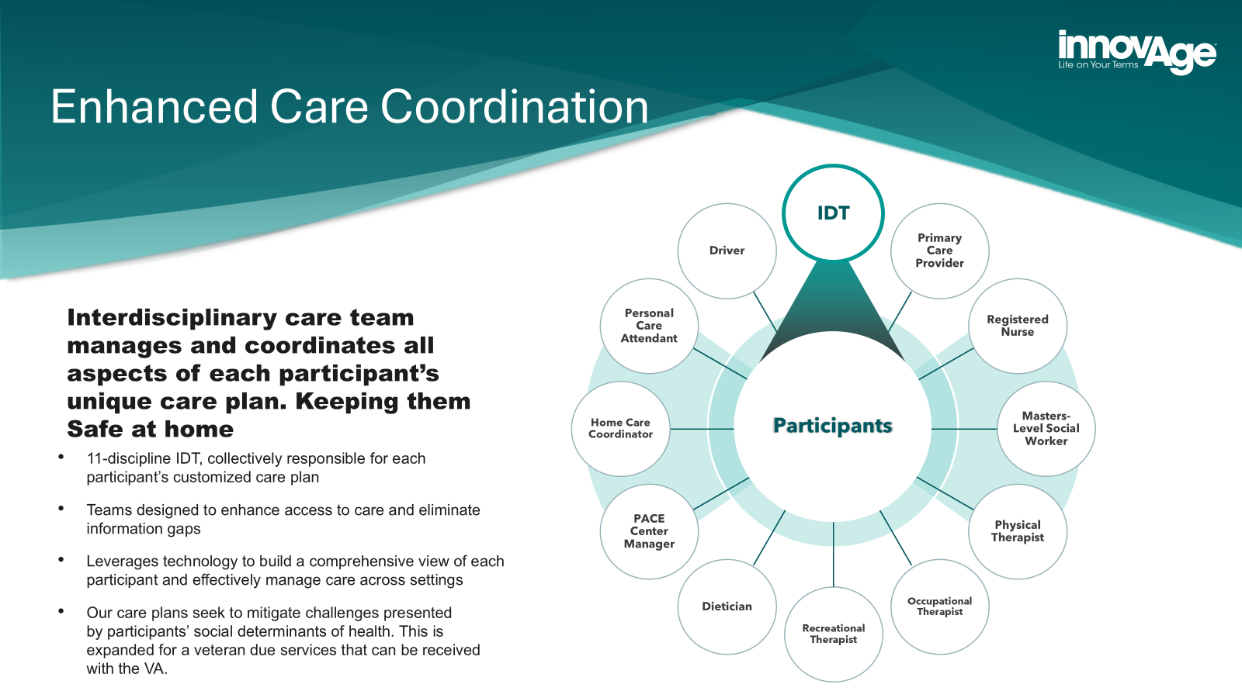

Slide 14

The Social Worker
The Social Worker oversees the care of each participant to provide a holistic experience. Participant benefit:
Single point-of-contact for all a participant’s needs.
Tracks participant’s status and reports changes to interdisciplinary care team (IDT) for potential adjustments to care plan.
When participants are no longer able to live independently, their social workers coordinate transition to InnovAge-contracted assisted living, skilled nursing, or memory care facilities. This overcomes the challenge Medicaid recipients face when seeking housing.
14

Slide 15
In-home services complement our center-based operations.
NEW
Task-based services address functional limitations of participants.
Together with the Health & Safety Determination team, our Interdisciplinary Care Team (IDT) develops a plan to ensure each participant remains as safe as possible while living independently at home.

Slide 16
What happens if participant loses ability to live independently?
When transitioning to a contracted ALF or SNF, a participant can continue to be cared for by InnovAge through end of life.
Participant benefit: Access to assisted living facilities and skilled nursing facilities through InnovAge contracts. Many facilities are no longer accepting new residents on Medicaid.

Slide 17
Transportation
Seat-to-Seat Service: from home to PACE Center and coordinated medical appointments – and back home Transportation is built into the program because lack of reliable transportation is a real barrier to effective healthcare (missed appointments, etc.) Drivers are members of the IDT – Interdisciplinary Team. They are the first to notice important signals that can impact a care plan.

Slide 18
Who’s a good candidate for PACE
1. Person age 65+:
On Medicare, On Medi-cal/Medicaid or may qualify
Has stable housing and has 2 or more ADL’s that qualifies them for PACE (amount of ADL’s state specific)
2. Person Age 55+
Has Medi-Cal/Medicaid or may qualify
Has stable housing, has 2 or more qualifying ADL’s (amount of ADL’s are state specific)
3. VA- age 55+
Has a 70% minimum service-connected disability
***Must reside in a covered Zip Code
18

Slide 19






PACE is positioned towards the end of the healthcare continuum.
Younger, healthier, individual with Commercial Insurance (or uninsured)
Becomes Medicare eligible due to age (65+) or disability (<65)
Becomes Medicaid eligible due to income and/or disability
Becomes eligible for Medicaid home and community-based services due to activities of daily living assistance (e.g., requires assistance with 1-2 ADLs)
Becomes nursing home eligible due to increased ADL needs (e.g., requires help with 2-4 ADLs as determined by state)
Becomes PACE participant to remain independent (Avg Age: 76)

Slide 20
PACE is different than a conventional health plan.
Health Plan
PACE
Secures State license
Develops provider network
Sells plans
Members advocate for their own care
CMS designates service area to PACE Organizations such as InnovAge
PACE Organization builds PACE Center
PACE Organization operates transportation fleet
PACE Organization develops eco-system to support operations (supplemental provider network, housing partners, dura-med suppliers, etc.)
IDT, a 12-member interdisciplinary team, manages and advocates for each participant
Program provides care through end of life

Slide 21










 | Original Medicare | Medicare Advantage | Medicaid Long-Term Services & Supports | PACE
Physician Care
Hospital Care
Pharmacy
Supplemental Benefits (e.g., Vision, Dental)
Home Health (Skilled)
Transportation¹
Home Care (Unskilled)
Adult Day Services
Assisted Living (when required)
Nursing Facility (when required)
PACE offers the most comprehensive healthcare benefits – commonly at no cost to participants.

Slide 22
We’re excited to be working with FMO’s/Brokers for the first time! This presents an increased opportunity to serve your clients who need the additional help and resources
Raise Awareness
Grow Enrollments
PACE has extraordinarily low awareness in the industry and publicly – likely because producers haven’t had access to it.
The Broker Channel represents majority of sales in the senior market.
InnovAge allows you the same lifetime renewal with eliminating service issues due to the longer enrollment process, which provides higher member retention.

Slide 23
Broker Comp
New:
FMO Contracts are available!
Broker Street level contracts are NOW available!
Lifetime compensation
FMV Initial
FMV Renewal

Slide 24

Understanding Innovage Tools for Brokers
Broker Portal Features
Commission Payment
Online Contracting/Certification
Sales Resource Tab
Includes: PDF doc library of InnovAge/PACE materials
Co-branded Marketing Pieces
Open Training Session Calendars
Company Alerts
Online Enrollment Tab
Covered Service area zip code entry
Online Enrollment Application w/ PACE Supplemental form.
Upload features
Ability to connect applicant with Innovage to schedule Intake Appointment
Reporting Tab
Commission statements
BOB report
Enrollment Status
Agents are paid direct FMV initial and renewal, chargebacks are assessed
FMO’s are paid direct separate
Innovage pays 3rd week of the month of the effective date of approval
Direct deposit is primary source of payment
FMV Renewals are annual advanced on 13th anniversary month in one payment.
Digital Agent Profile/ Contracting
Upload features for DOI License, E&O
Online Certification
Annual Self study digital slides of Innovage PACE model followed by a test with three attempts to pass 80% or greater (30-45 minutes)
RTS- Ready to sell status
Digital notification to FMO/Broker also recorded in your agent profile
Annual reminders to certify, license & E&O renewals
Go Live ETA
FMO- August 7
Broker – August 15th

Slide 25

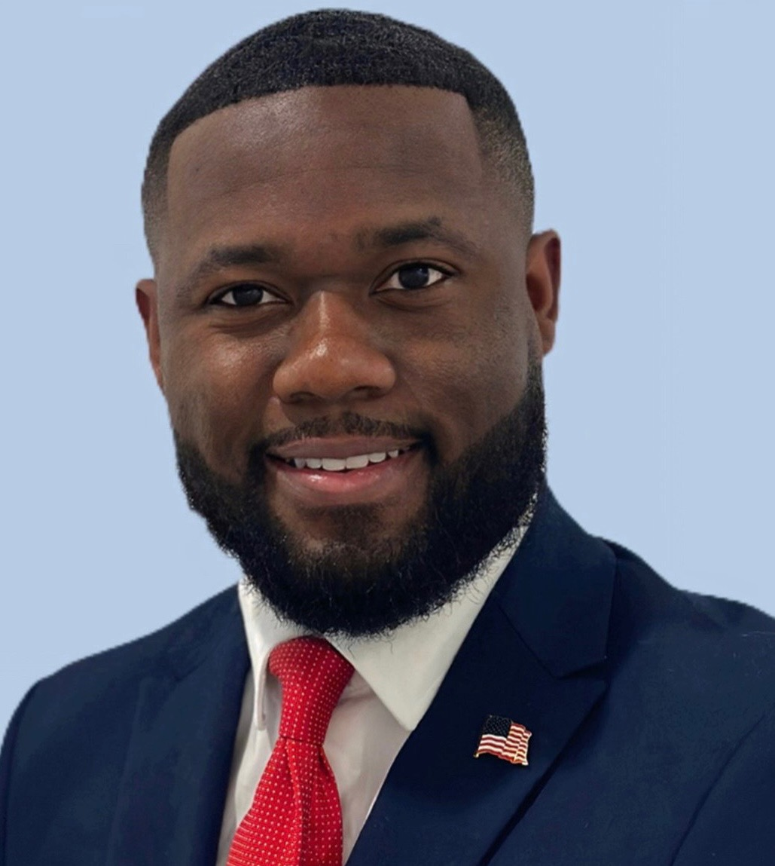

InnovAge Broker Channel Contacts:
Sheri Hernandez, Broker Channel Sales Director
C: 916-847-5227 E: Shernandez1@innovage.com
Steven Mezidor
Strategic Account Manager
E:smezidor@innovage.com C:561-890-6237
Ron Zighelboim Strategic Broker Partnerships
C:970.792.5047 E: rzighelboim@innovage.com

